Slide 1
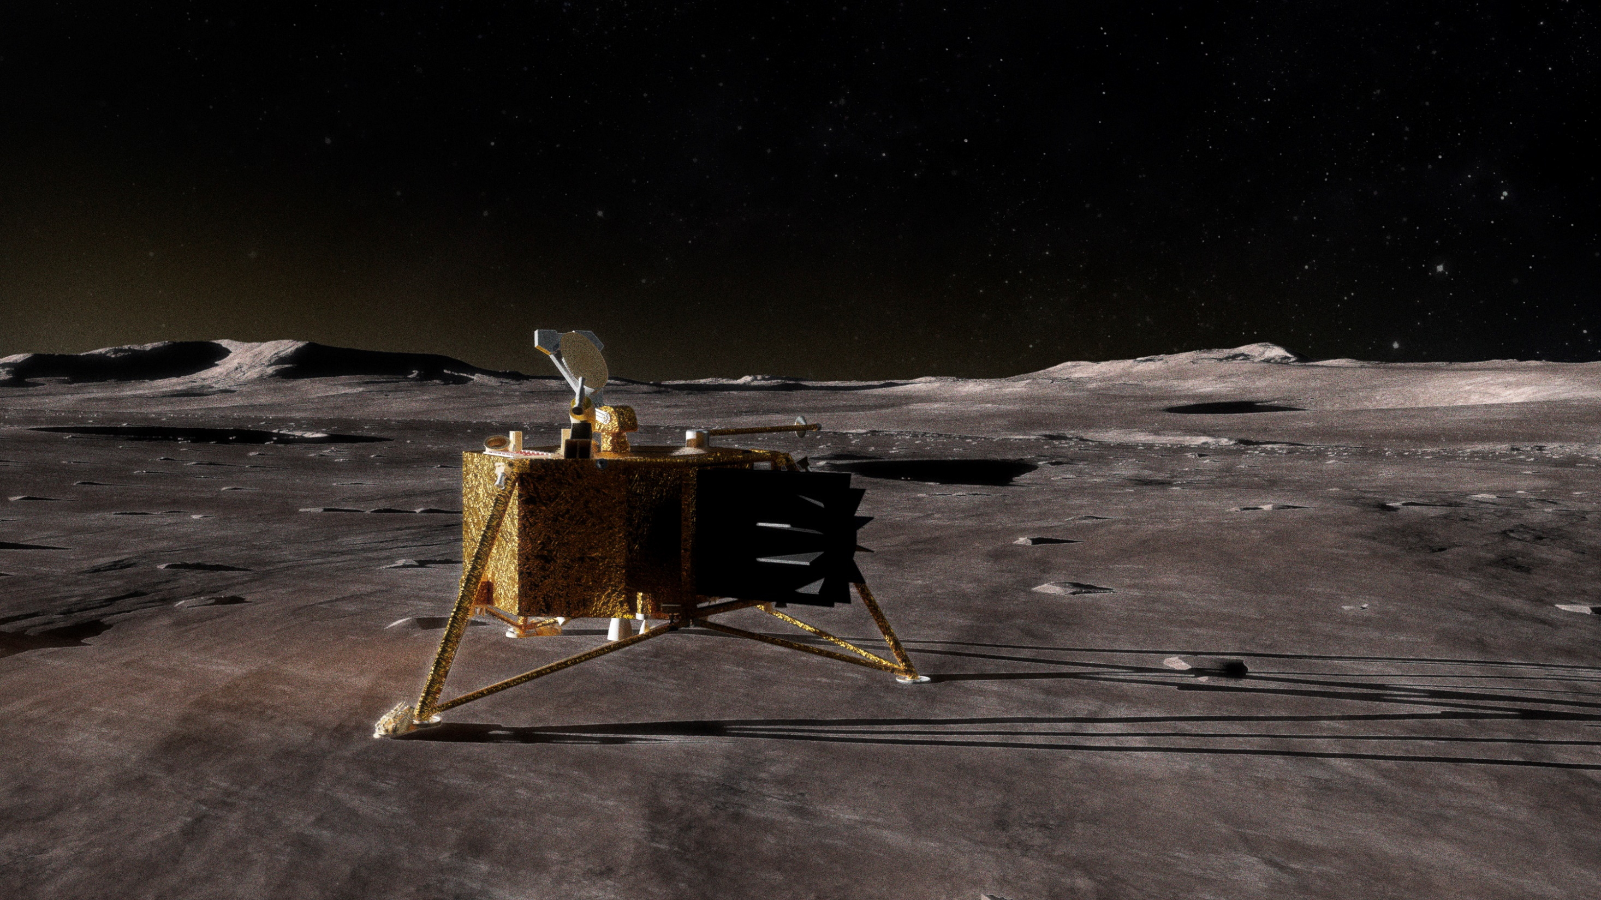
Mercury Lander
Planetary mission concept study for the 2023-2032 Decadal
Sanae Kubota
Johns Hopkins University Applied Physics Laboratory
Carolyn Ernst, Principal Investigator
Johns Hopkins University Applied Physics Laboratory
Engineering Team (APL):
Sanae Kubota; Gabe Rogers; Norman Adams; Justin Atchison; Dewey Barlow; Brian Bubnash; Stewart Bushman; Douglas Crowley; Jack Ercol; Derick Fuller; Daniel Gallagher; Meagan Hahn; Allan Holtzman; Justin Kelman; Kathy Kha; Christopher Krupiarz; Donald Mackey; Deva Ponnusamy; Jackson Shannon; Benjamin Villac
Science Team:
Nancy Chabot, APL (Deputy PI); Rachel Klima, APL (Project Scientist); Paul Byrne, NCSU; Steven Hauck, CWRU; Kathleen Vander Kaaden, Jacobs/JSC; Ron Vervack, APL; Sebastien Besse, ESA; David Blewett, APL ;Brett Denevi, APL; Sander Goossens, UMBC; Stephen Indyk, Honeybee; Noam Izenberg, APL; Catherine Johnson, PSI; Lauren Jozwiak, APL; Haje Korth, APL; Ralph McNutt, APL; Scott Murchie, APL; Patrick Peplowski, APL; Jim Raines, University of Michigan; Elizabeth Rampe, JSC; Michelle Thompson, Purdue; Shoshana Weider, NASA HQ (NASA POC)

Slide 2
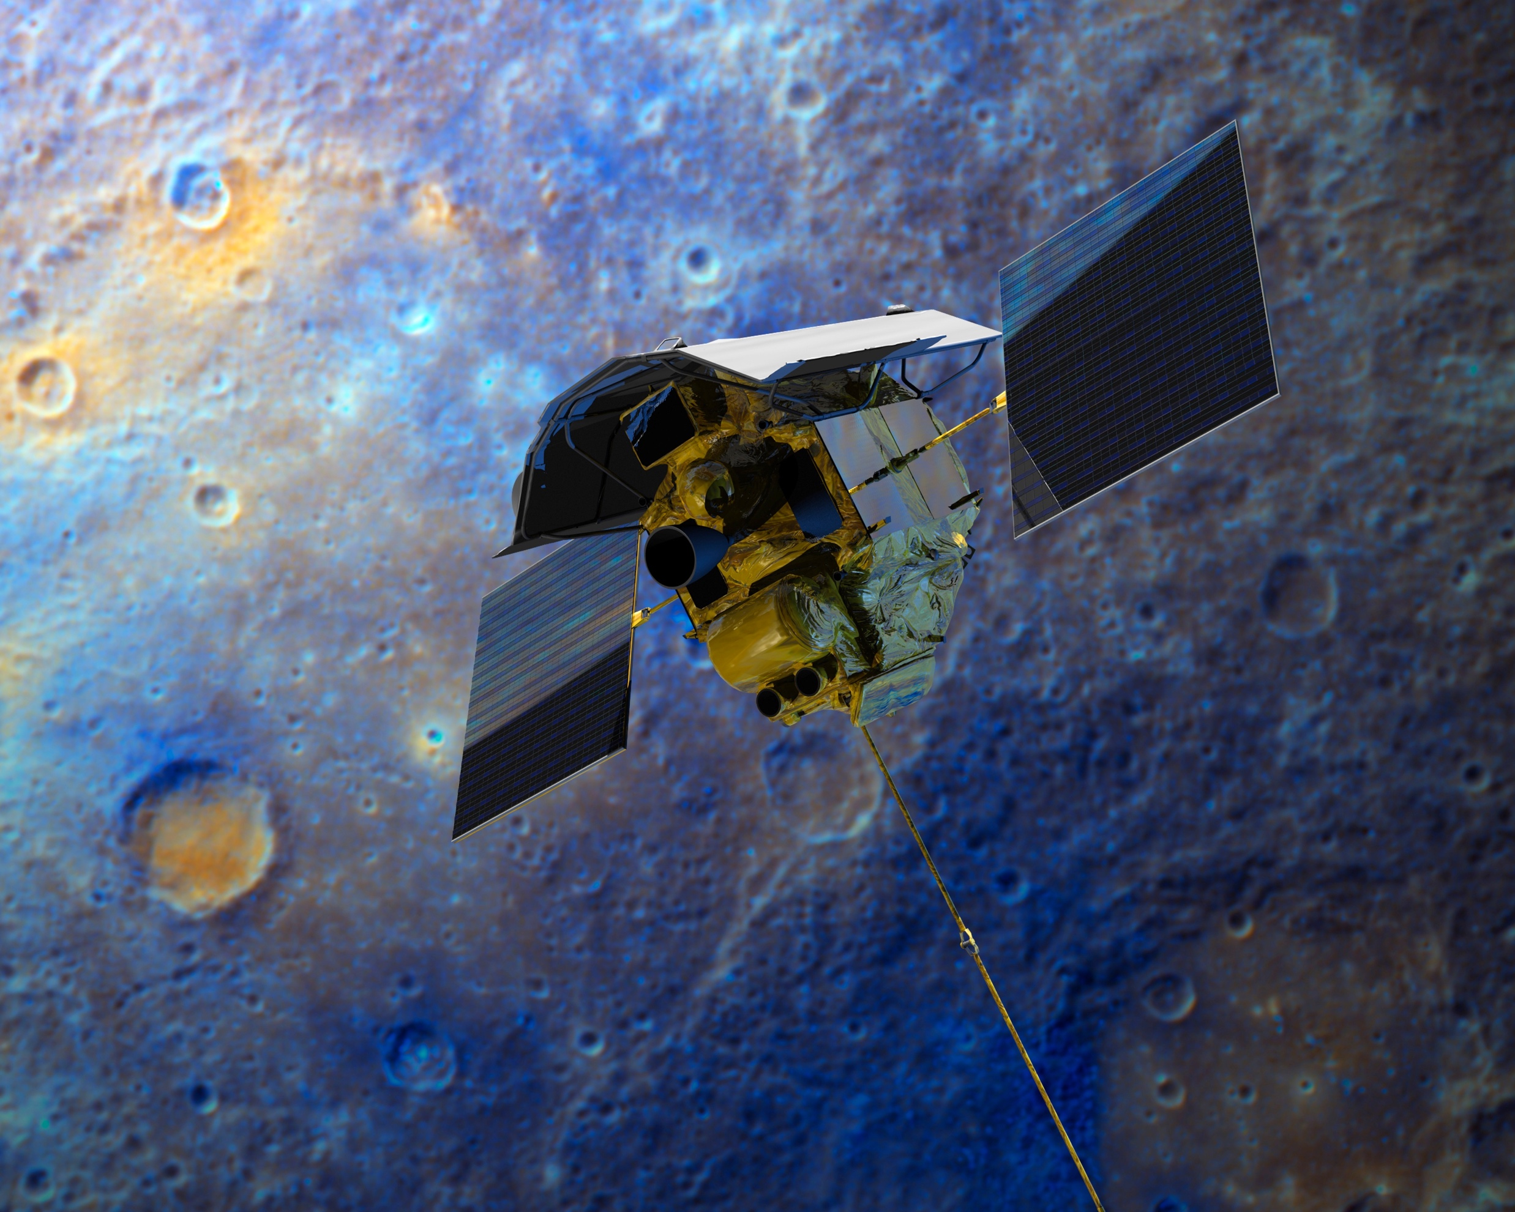
Spacecraft Reconnaissance of Mercury
Mariner 10 (NASA)
  Launched 1973
  3 flybys of Mercury in 1974/1975
MESSENGER (NASA)
  Launched 2004
  3 flybys of Mercury in 2008/2009
  Orbital reconnaissance 2011–2015
BepiColombo (ESA/JAXA)
  Launched 2018
  Several flybys of Mercury from 2021–2025
  Orbital reconnaissance 2025–2028
flyby ✓
orbit ✓
land _

Slide 3
Why Land on Mercury?
MESSENGER revealed Mercury’s highly chemically reduced and unexpectedly volatile-rich composition
Unique among the terrestrial planets
Unlike any predictions of previously proposed hypotheses of the planet’s origin
Goal 1 (geochemistry): Investigate the highly chemically reduced, unexpectedly volatile-rich mineralogy and chemistry of Mercury’s oldest terrain to understand the earliest evolution of this end-member of rocky planet formation.
In situ measurements from the surface are needed to:
Understand Mercury’s unique mineralogy and geochemistry;
Constrain the massive core’s structure;
Measure its active and ancient magnetic fields at the surface;
Goal 2 (geophysics): Investigate Mercury’s interior structure and magnetic field to unravel the planet’s differentiation and evolutionary history and understand the magnetic fields at the surface.
Goal 3 (Mercury environment): Investigate the active processes that produce Mercury’s exosphere and alter its surface to understand planetary processes on rocky airless bodies, including the Moon.
Investigate the processes that alter its surface and produce its exosphere;
Provide ground-truth for remote datasets.
Goal 4 (geology): Characterize the landing site to understand the processes that have shaped its evolution, place the in situ measurements in context, and enable ground truth for global interpretations of Mercury.
As an end-member of terrestrial planet formation, Mercury holds unique clues about the original distribution of elements in the earliest stages of the solar system and how planets (and exoplanets) form and evolve in close proximity to their host stars.

Slide 4
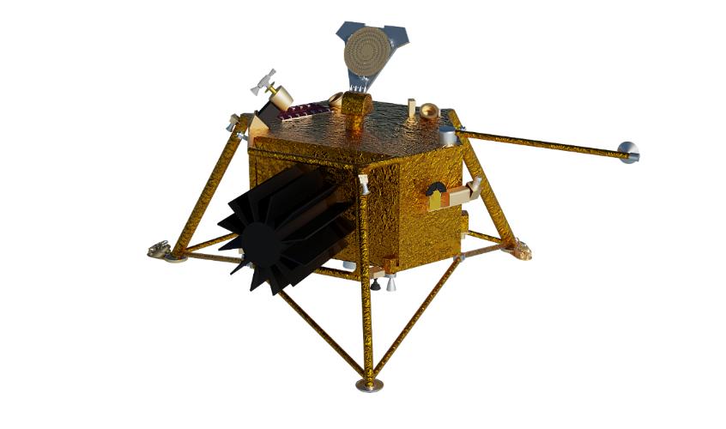
2010 & 2020 Planetary Decadal Survey studies
The importance of in situ measurements via a landed mission to Mercury has been recognized across decades, even prior to MESSENGER’s orbital campaign.
  2013 – 2022 Decadal Survey: “Given all the advances that will likely come from MESSENGER and BepiColombo, as well as ongoing technology and capability enhancement work, the high-priority of Mercury landed science could be revisited at the earliest opportunity mid to late in this decade.”
  Selection for a Planetary Mission Concept Study in support of the 2023 – 2032 Decadal Survey.
Mercury Lander mission concept study performed in 2010 in support of 2013-2022 Decadal Survey.
  Challenges highlighted: launch energy and deltaV
    Low-thrust and ballistic trajectories with reduced and robust payloads explored, all well outside New Frontiers cost cap.
    Recommended exploration of qualifying higher energy launch vehicle configurations.
  Study was conducted prior to MESSENGER’s orbital campaign; science case for a landed mission further strengthened by unexpected findings from MESSENGER mission.
Relevant changes since 2010:
  Expanded launch vehicle options, performance capability
  Further solar electric propulsion development
  NextGen RTG development
  New Frontiers costing rules
2020 study edict: “Establish if a Mercury Lander mission is feasible as a New Frontiers class mission.”
Finding: “Yes.”
flyby ✓
orbit ✓
land □

Slide 5
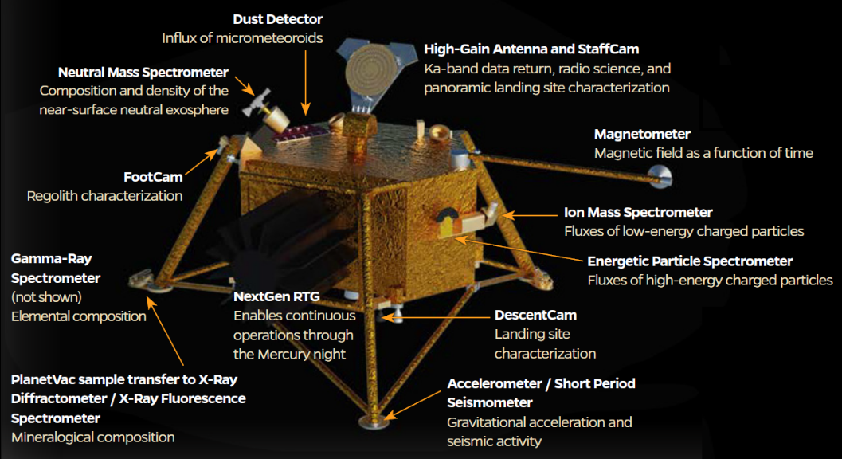
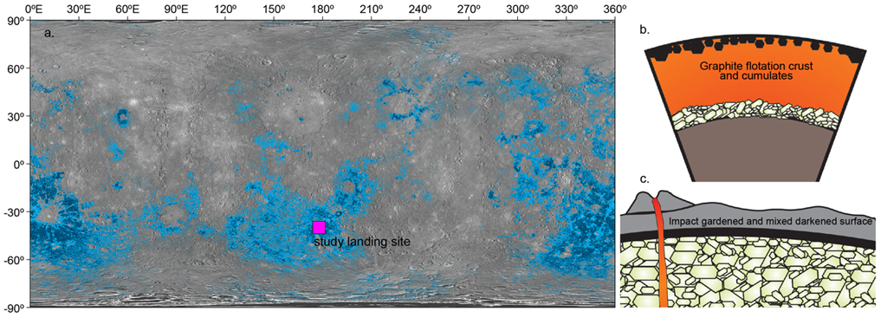
Mission Concept Overview
A New-Frontiers-class mission concept which achieves one full Mercury year (~88 Earth days) of surface operations with an 11-instrument, high-heritage payload delivered to a landing site within Mercury’s widely distributed low-reflectance material (LRM).
  The selected payload suite addresses science goals encompassing geochemistry, geophysics, the Mercury space environment, and geology.
  LRM is believed to be remnants of Mercury’s ‘exotic’ graphite flotation crust and to represent the earliest solid crustal materials on Mercury, providing a unique window into the planet’s earliest differentiation.
  LRM locations are widely distributed across the planet providing flexibility for a mission concept study with the overall goal of investigating the feasibility of a landed mission to Mercury without being overly constrained by a specific choice of landing site.

Slide 6
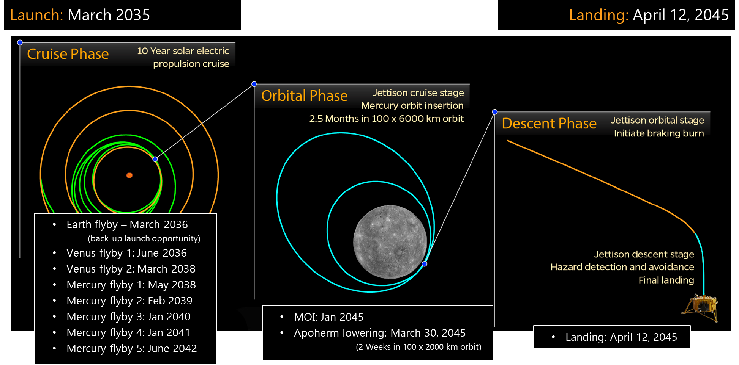
Mission Timeline

Slide 7
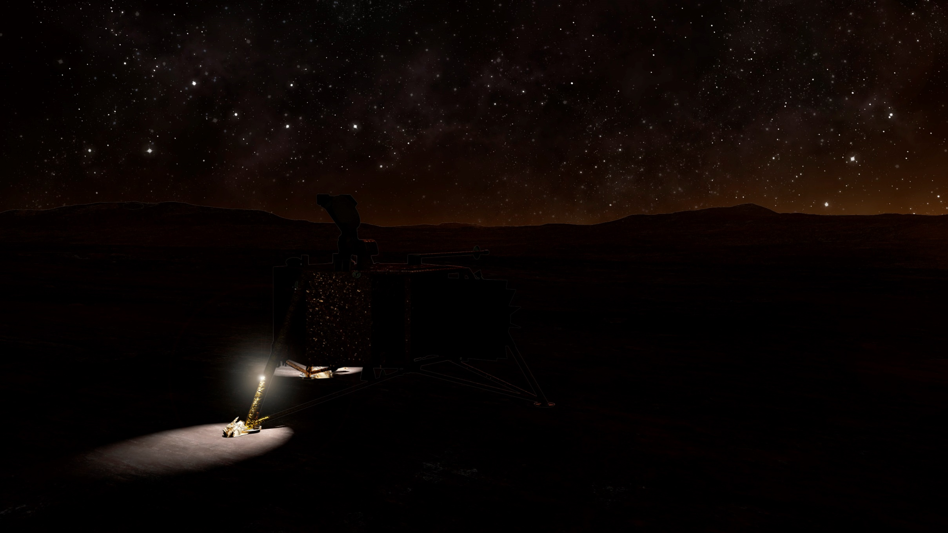
Key Challenges
Large deltaV requirement to reach Mercury
Large deltaV requirement to orbit Mercury
Large deltaV requirement to land on Mercury
Extreme thermal environment around Mercury
Extreme thermal environment on Mercury
Limited surface characterization of Mercury

Slide 8
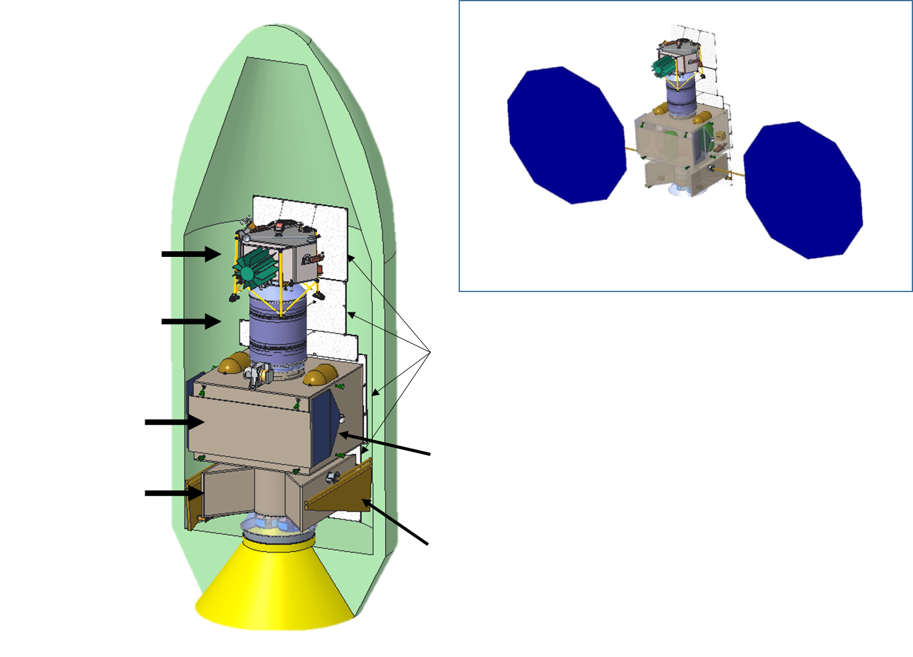
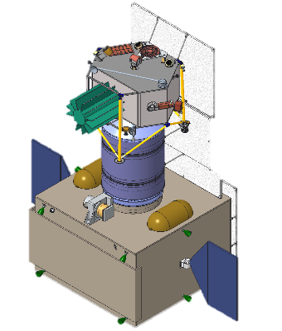
Four Stage Design: Cruise & Orbit
The primary challenges of a Mercury Lander mission are addressed with a four-stage design that launches on an expendable Falcon Heavy vehicle.
  Mass savings are enabled through jettison of stages prior to large burns and optimization of propulsion systems for each phase: cruise, orbit, initial descent, and landing.
Cruise:
  Minimized fuel load via solar electric propulsion system (SEP) for a low-thrust trajectory to Mercury.
  10 year trajectory launches on an expendable Falcon Heavy with C3 = 14.7 km²/s²
  One Earth, two Venus, and five Mercury gravity assists.
  Cruise stage jettisoned after orbit matching with Mercury
Orbit:
  Bipropellant orbital stage executes Mercury Orbit Insertion burn, bringing the remaining 3 stages to a thermally safe orbit for 2.5 month orbital phase.
  Executes apoherm- and periherm-lowering maneuvers to prepare for descent.
  Orbital stage jettisoned prior to braking burn.
  Use of SEP for orbit insertion, station-keeping, and orbit-lowering maneuvers was evaluated but results in significantly longer flight times than the use of chemical propulsion.
    SEP use would result in substantial increases to solar array size and mass to accommodate both solar cell degradation and decreased efficiency due to off-pointing needed to maintain solar cell temperatures in Mercury orbit.
Orbit Configuration

Slide 9
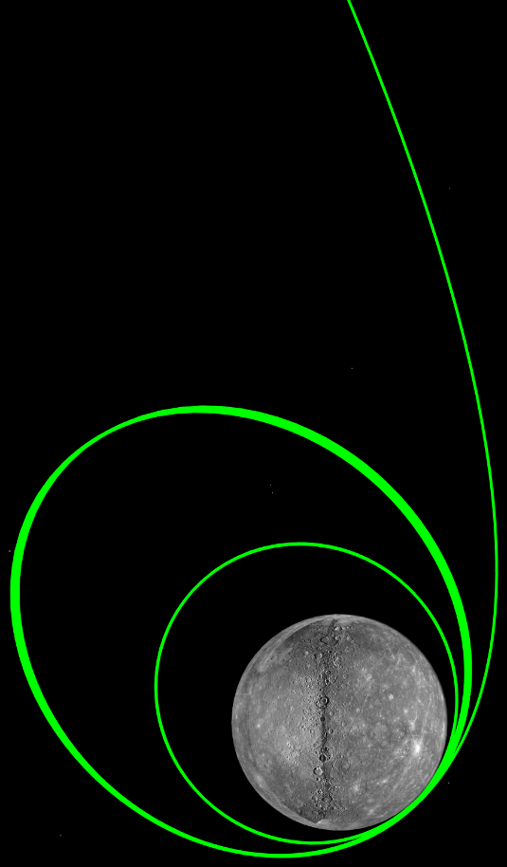
Extreme Thermal Environment Around Mercury:
Orbit Selection
Early trade studies investigated a dedicated landing site imaging orbital campaign. Found to be prohibitive due to thermal constraints of low orbits.
At perihelion, 11 times the solar radiation experienced near Earth
MESSENGER-like sunshades protect each stage from the Sun
Spacecraft passes between the Sun and the illuminated planet, exposing the vehicle to the hot Mercury surface
Severity depends not only on altitude but also location relative to subsolar point
Comprehensive trade study performed for orbit selection, 100 km x 6000 km orbit with argument of periapsis of 320 deg chosen
  Safe storage orbit minimizes peak planetary heating and keeps the maximum orbit average sink temperature of the stages behind the sunshades at or below 0°C
  SRM is maintained at 30°C
  Maximum predicted RTG temperature is in family with New Horizons RTG during first six months of mission
Apoherm and periherm lowering maneuvers are executed beyond Mercury True Anomaly of 130° to set up for descent at aphelion from 20km altitude with a near-terminator orbit.
  Maintains safe SRM temperatures with orbit average sink below 10°C.

Slide 10
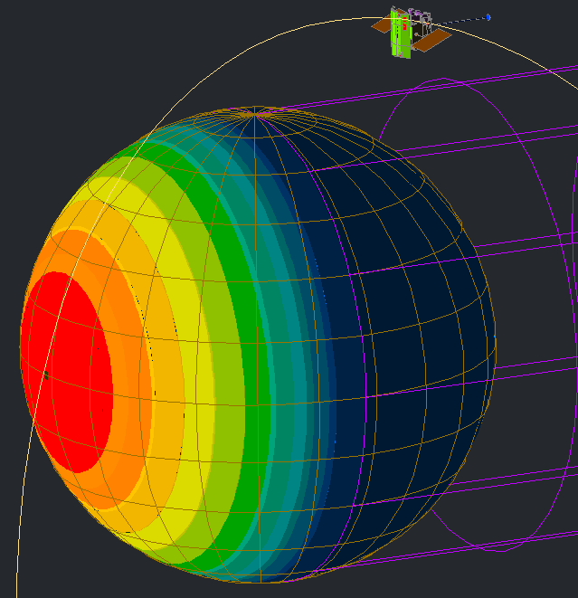
Extreme Thermal Environment On Mercury
Thermal environment during Mercury day is prohibitive for both solar array and RTG power sources.
Landing at low sun elevations (near the terminator) keeps surface temperatures < 40°C
  Allows Lander to shade the RTG
  Sun elevation < 5° when landing at Mercury aphelion, < 2° at perihelion
Landing near dusk and operating through the night allows for operation through a full Mercury year
335 ˚C
-163 ˚C
425 ˚C
451 ˚C

Slide 11
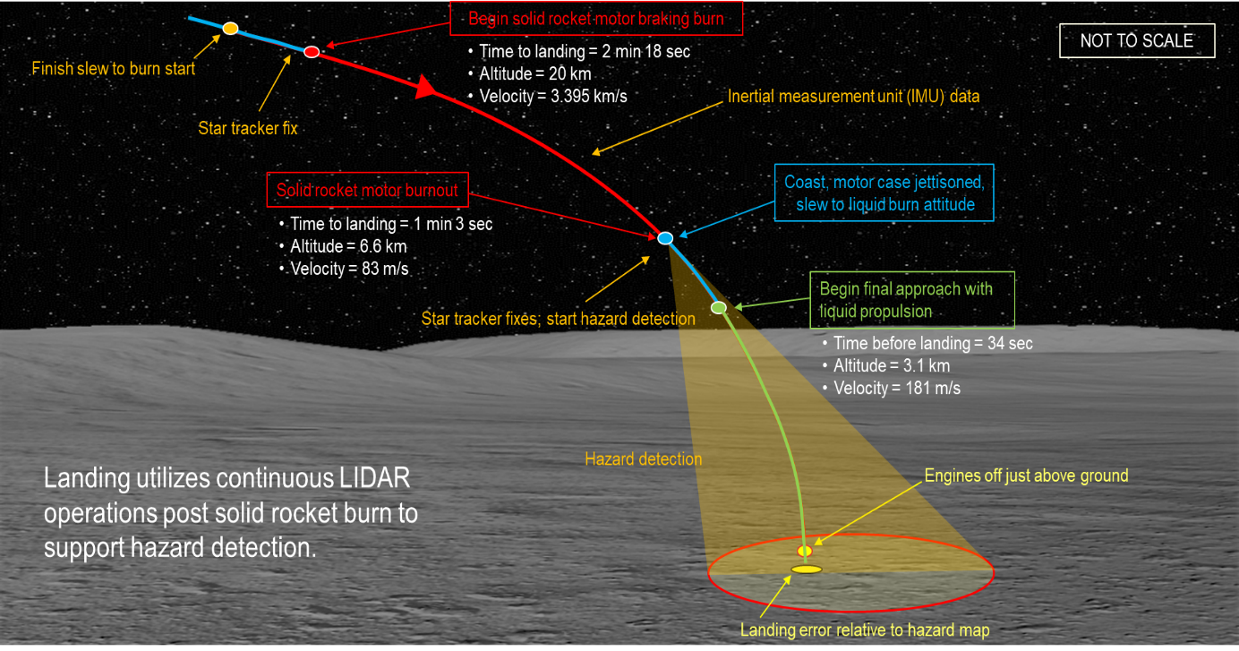
Four Stage Design: Descent & Landing
The Orbital Stage includes a Lunar Reconnaissance Orbiter Narrow Angle Camera-analog, enabling 1 m/pixel scale imaging of the landing area from 100km altitude for final down-select of the target landing zone during the 2.5 month orbital phase.
  Supplements detailed mapping and modeling studies performed on MESSENGER and BepiColombo data.
A hazard map is produced by scanning LIDAR during the coast arc ahead of the final descent, from ~3 km altitude, and a target landing site is selected to maximize distance from hazards before ignition of the Lander LPS engines.
  Scanning LIDAR performance estimates range from ~0.5 m²/px over 400m x 400m to better than 0.1 m²/px over a 540m x 540m area (dependent on sampling rate chosen, 10 kHz or 100 kHz respectively).
  Hazard map continues to be refined with increasing resolution on descent.
Initial descent:
  Solid Rocket Motor Descent Stage
  ~3.4 km/s braking burn in airless, high gravity environment
  Jettisoned after burnout
Landing:
  Bipropellant Lander
  Final soft landing with hazard detection/avoidance

Slide 12
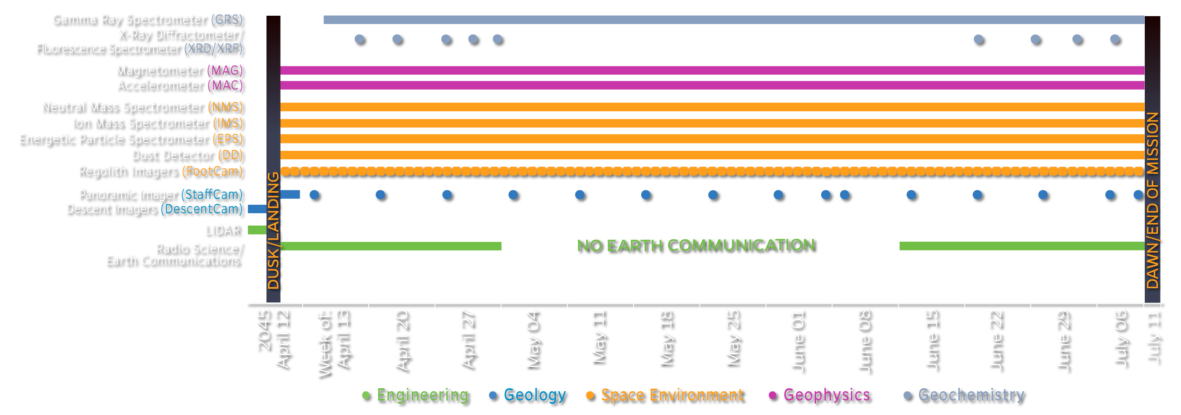
One Full Mercury Year of Surface Operations

Slide 13
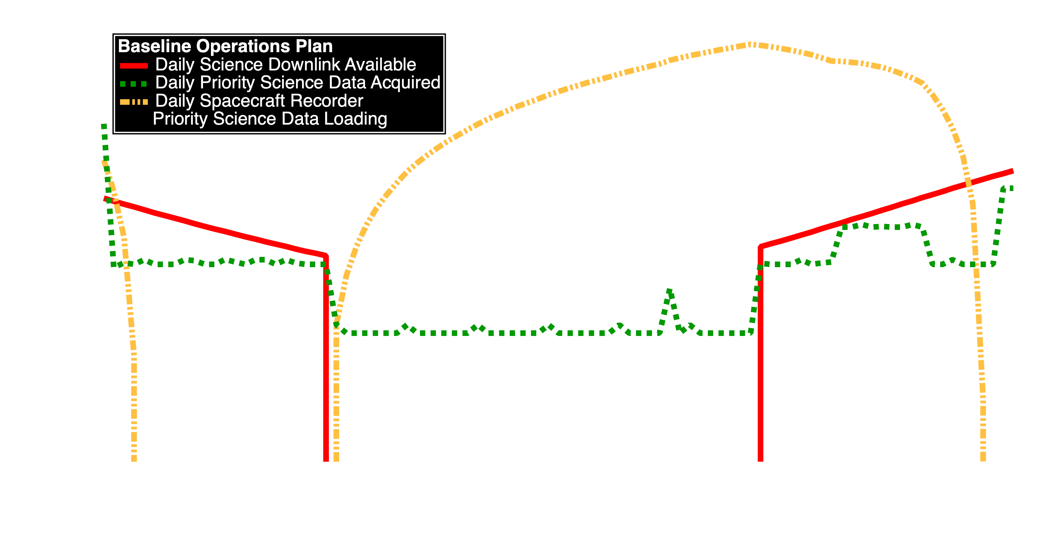
Surface Operations Data Return
Baseline Plan:
10.8 GB total data
Direct to Earth downlink, one 34-meter Ka band,
24 hrs/day when geometry allows, meets all science goals for the full payload
 | NMS | IMS | EPS | DD | GRS | XRD/XRF# | MAG | MAC | StaffCam | FootCam | DescentCam | TOTAL
Surface Ops Description | Cont* | Cont* | Cont* | Cont* | Cont | Specific Collection Times | Cont* | Cont* | Specific Collection Times | Daily | Descent Only
Total Data Volume Downlinked (MB) | 228 | 1138 | 228 | 228 | 484 | 93 | 1422 | 4619** | 773 | 1138 | 469 | 10,820
* Continuous except for during XRD/XRF analyses # Includes XRD/XRF and PlanetVac data ** Only difference between data acquired and data downlinked; MAC acquires 7111 MB of data.

Slide 14
